Slide 1
PREVENT
User manual
By shakir dossa

Slide 2
contents
Acknowledgments
About me
My Internship Journey
About the App
How to use it?
Contact Information
Thank you

Slide 3
Acknowledgments
First I want to thank Mr Ken for the amazing feedback he gave me which really assisted me in the making of my app. Secondly, I would like to thank my Clevered Mentors: Mrs Shivani and Mrs Smita you both have been really helpful in teaching and answering my questions, queries. Lastly, I would like to thank Mr Avishek Das who hass been my teacher for Clevered sessions and got me interested in coding.

Slide 4
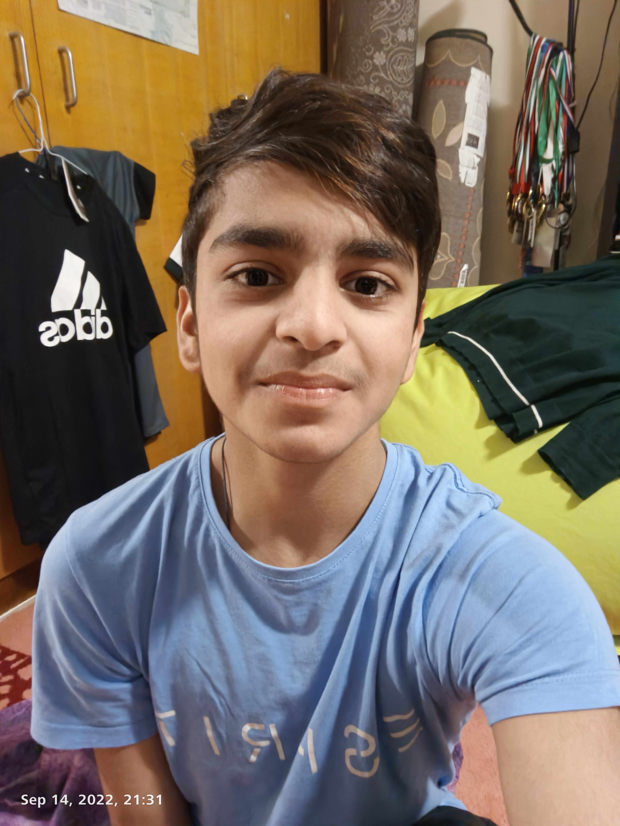
About ME…
My name is Shakir Dossa, I am in grade 11 and study in Dubai. I love playing football in my spare time and when I can’t I also enjoy reading. I aspire to become a doctor in the future and hope to take along some helpful coding skills along with me. I have learned many python skills and am now learning how to use different and more advanced libraries. In the future I hope to learn more complex languages to further enhance my knowledge.

Slide 5
My internship journey
It has been a delight meeting, receiving feedback from both Mr Ken and my mentors.
I have gotten three rockstar badges and have learned a lot about python
More recently I learned how to make a user interface using python for my diabetes prediction app.

Slide 6
About PREVENT
The app has the user input certain values of medicinal information such as insulin levels, glucose levels and blood pressure. From these it determines whether you have or don’t have diabetes. If you do it recommends a diet plan for the user to help assist in recovering from diabetes. If it doesn’t think the user has diabetes but has abnormal levels of a certain input then it would recommend a different treatment plan.

Slide 7
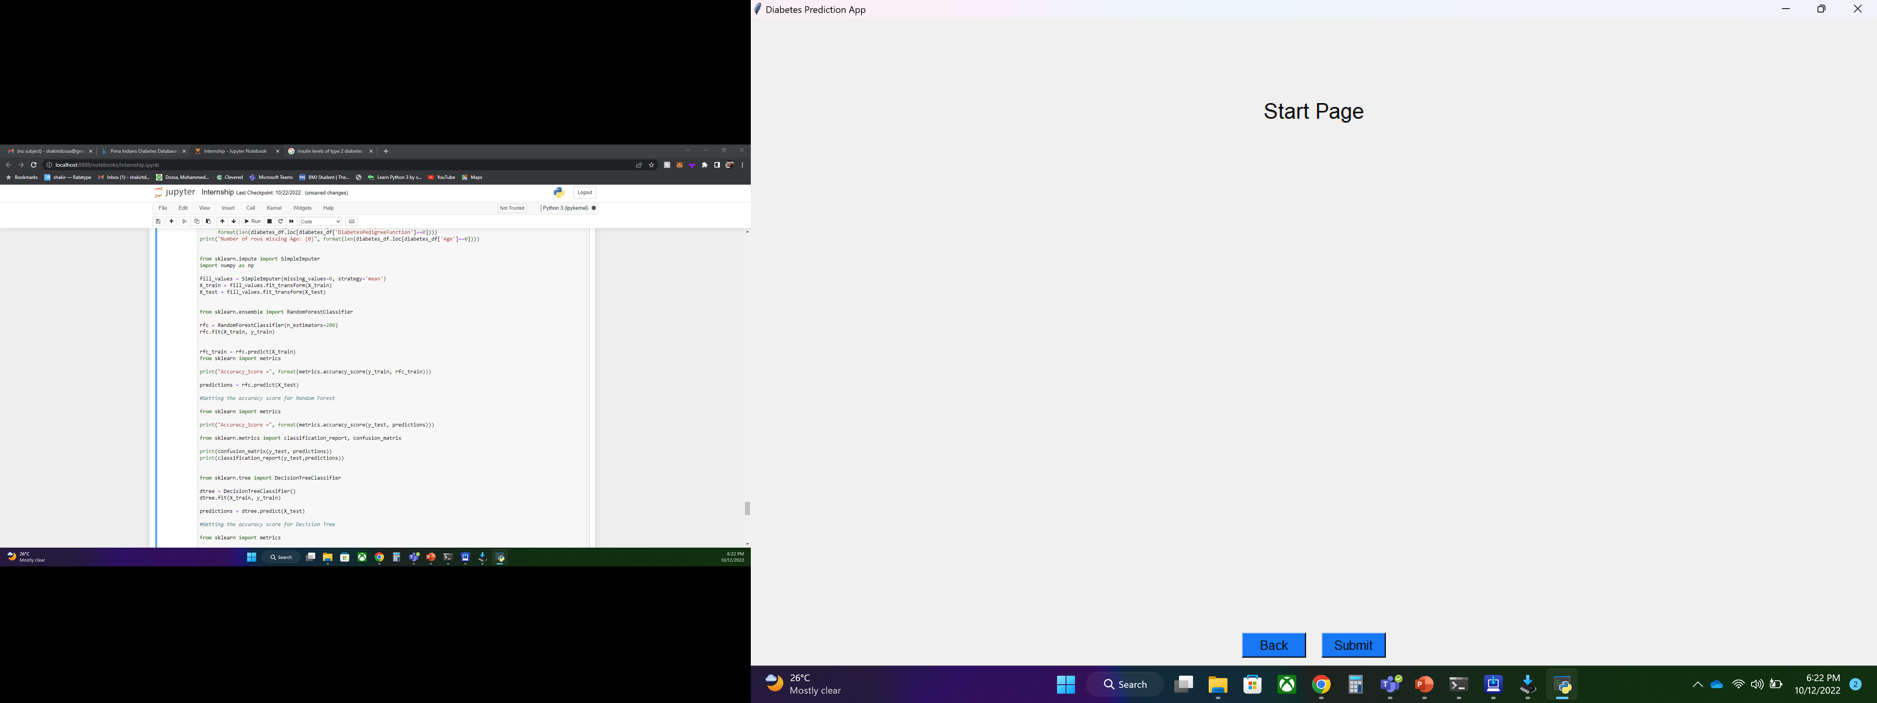



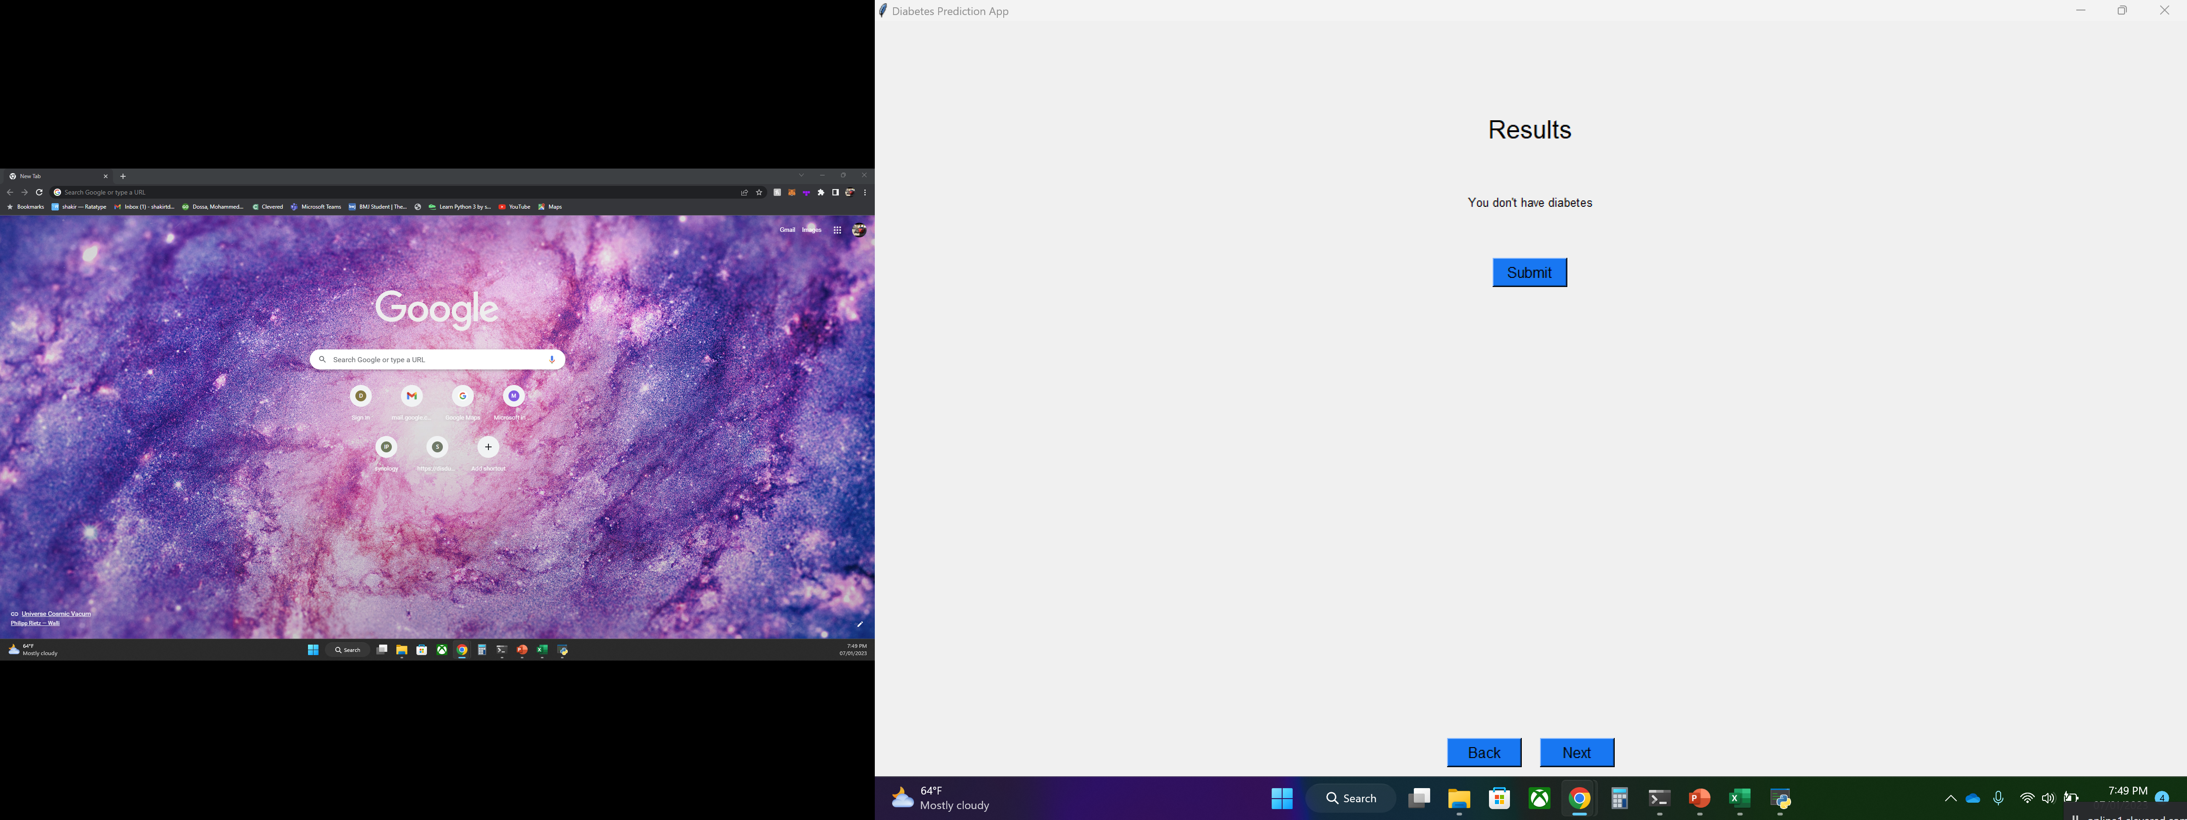
How to use it
Enter integer value
Enter integer value
Enter integer value
Enter integer value

Slide 8
Please feel free to reach out to me at shakirtdossa@gmail.com for any questions about the app

Slide 9
Thank you!

